Slide 1
Big Data, Data Warehouses, and Business Intelligence Systems
DAVID M. KROENKE and DAVID J. AUER
DATABASE CONCEPTS, 7th Edition
Chapter Eight

Slide 2
Chapter Objectives
Learn the basic concepts of Big Data, structured storage, and the MapReduce process
Learn the basic concepts of data warehouses and data marts
Learn the basic concepts of dimensional databases
Learn the basic concepts of business intelligence (BI) systems
Learn the basic concepts of Online Analytical Processing (OLAP)

Slide 3
Big Data
The rapidly expanding amount of data being stored and used in enterprise information systems
Search tools
Google
Bing
Web 2.0 social networks
Facebook
LinkedIn
Twitter

Slide 4
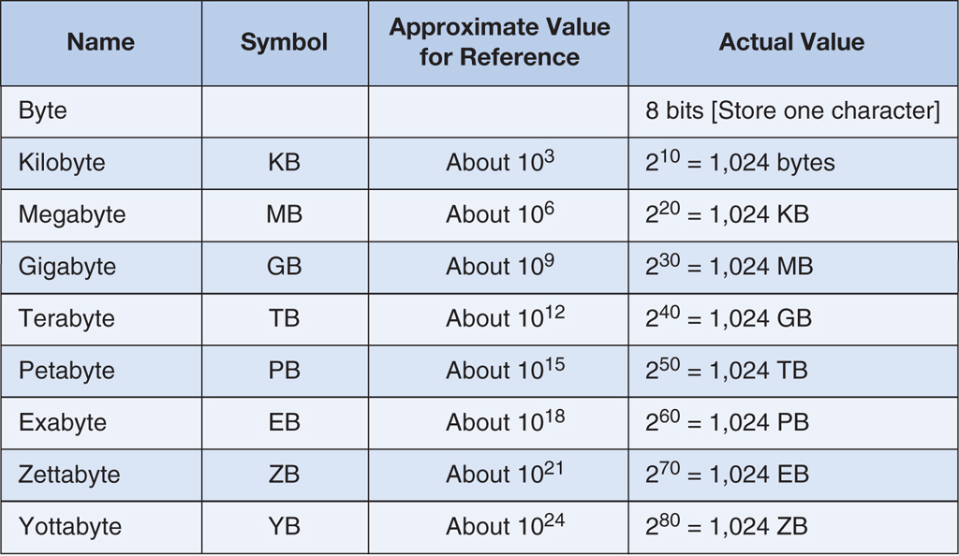
Storage Capacity Terms
Figure 8-1: Storage Capacity Terms

Slide 5
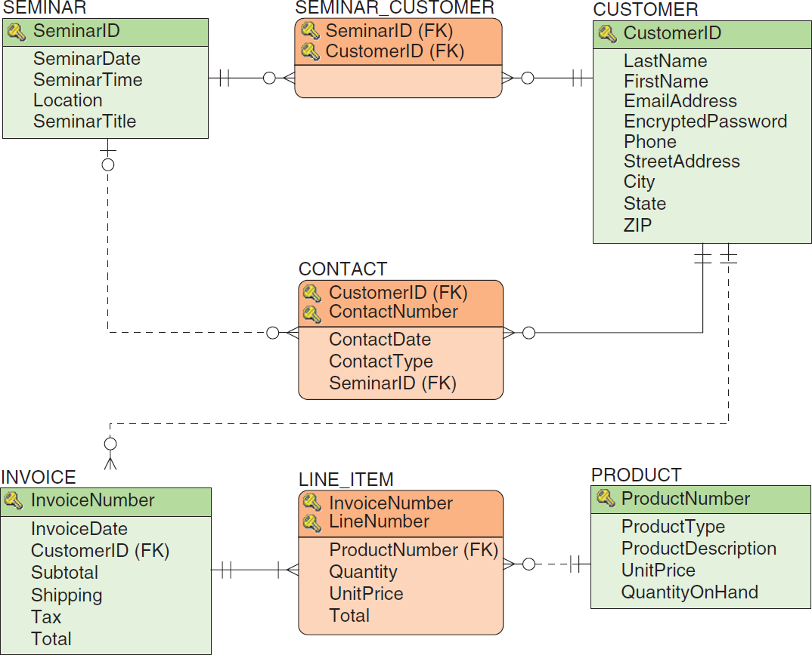
Heather Sweeney Designs Review: Database Design

Slide 6
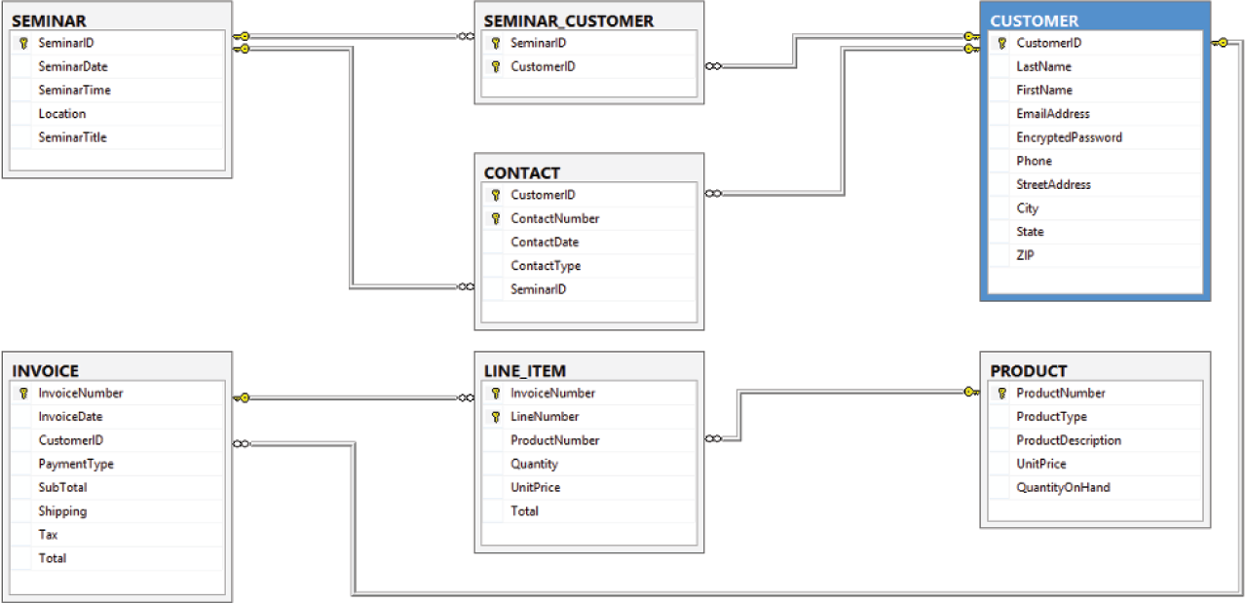
Heather Sweeney Designs Review: HSD Database Diagram in SQL Server 2014
Figure 8-2: The HSD Database Diagram

Slide 7
Business Intelligence Systems
Business intelligence (BI) systems are information systems that
Assist managers and other professionals in the analysis of current and past activities and in the prediction of future events.
Do not support operational activities, such as the recording and processing of orders.
These are supported by transaction processing systems.
Support management assessment, analysis, planning and control.
BI systems fall into two broad categories:
Reporting systems that sort, filter, group, and make elementary calculations on operational data.
Data mining applications that perform sophisticated analyses on data; analyses that usually involve complex statistical and mathematical processing.

Slide 8
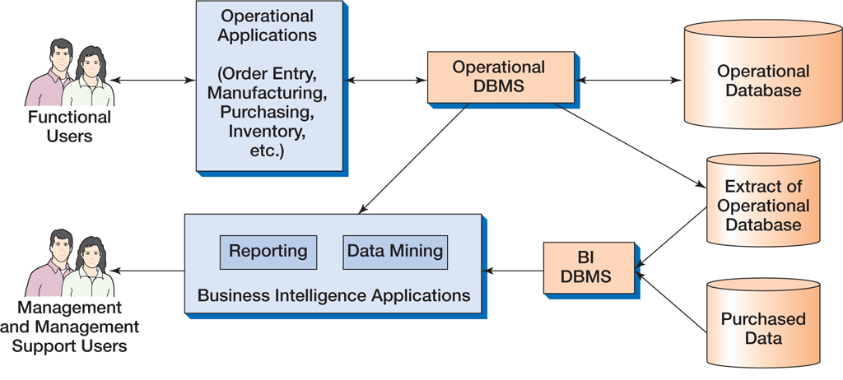
The Relationship Among Operational and BI Applications
Figure 8-3: The Relationship Between Operational and BI Applications

Slide 9
Characteristics of Business Intelligence Applications
Figure 8-4: Characteristics of Business Intelligence Applications

Slide 10
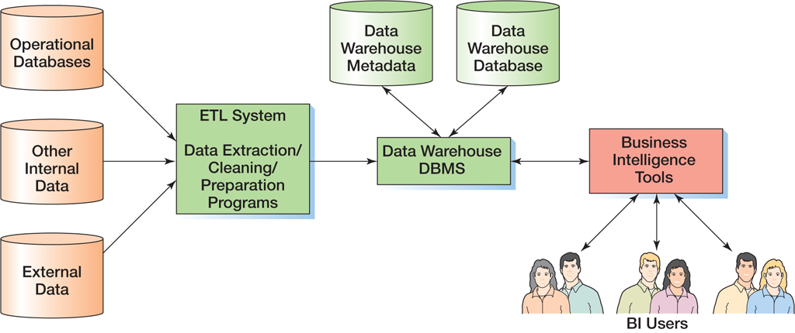
Components of a Data Warehouse
Figure 8-5: Components of a Data Warehouse

Slide 11
Problems with Operational Data
“Dirty Data”
Example – “G” for Gender
Example – “213” for Age
Missing Values
Inconsistent Data
Example – data that has changed, such as a customer’s phone number

Slide 12
Problems with Operational Data (Continued)
Nonintegrated Data
Example – data from two or more sources that need to be combined
Incorrect Format
Example – time data in hours when needed in minutes
Too Much Data
Example – An excess number of columns

Slide 13
ETL Data Transformation
Data may need to be transformed for use in a data warehouse.
Example
{CountryCode → CountryName}
“US” → “United States”
Example
Email address to Email domain
joe@somewhere.com → “somewhere.com”

Slide 14
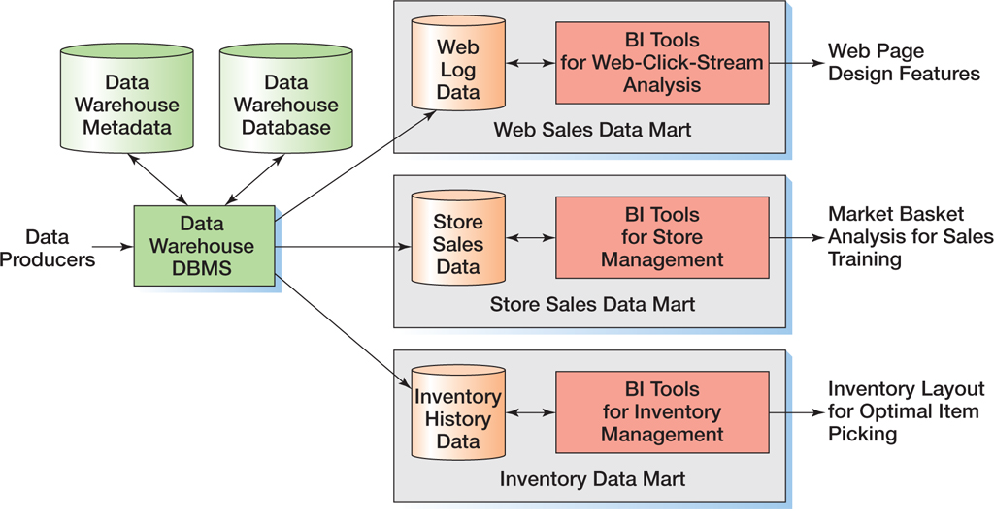
Characteristics of a Data Mart
Figure 8-6: Data Warehouses and Data Marts

Slide 15
Enterprise Data Warehouse (EDW) Architecture
Combines the data warehouse structure and the data mart structures shown above
Expensive to create, staff and operate
Smaller organizations use subsets of the EDW architecture

Slide 16
Dimensional Databases
A non-normalized database structure used for data warehouses
May use slowly changing dimensions
Values change infrequently
Phone Number
Address
Use a Date or Time dimension
Figure 8-7: Characteristics of Operational and Dimensional Databases

Slide 17
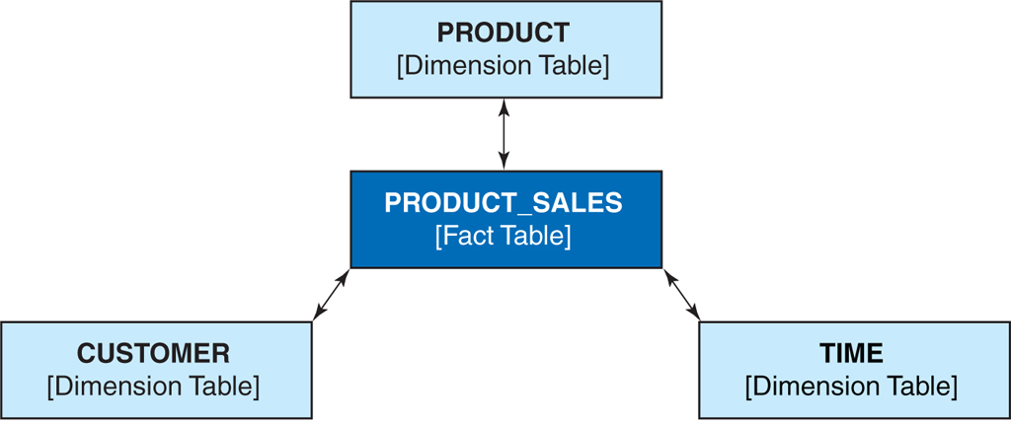
Star Schema
Figure 8-8: The Star Schema

Slide 18
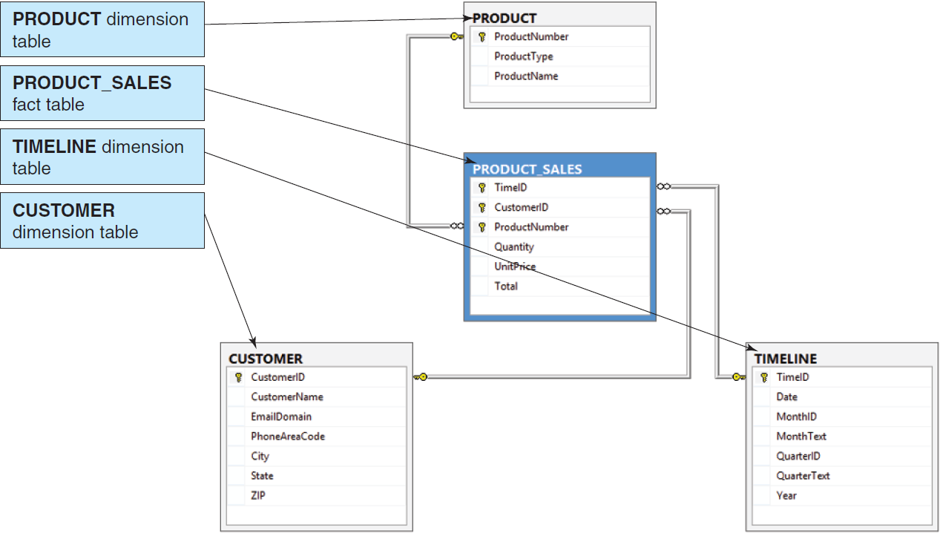
HSD-DW Star Schema
Figure 8-9: The HSD-DW Star Schema

Slide 19
Two-Dimensional Matrix
Figure 8-13: The Two-Dimensional ProductNumber–CustomerID Matrix

Slide 20
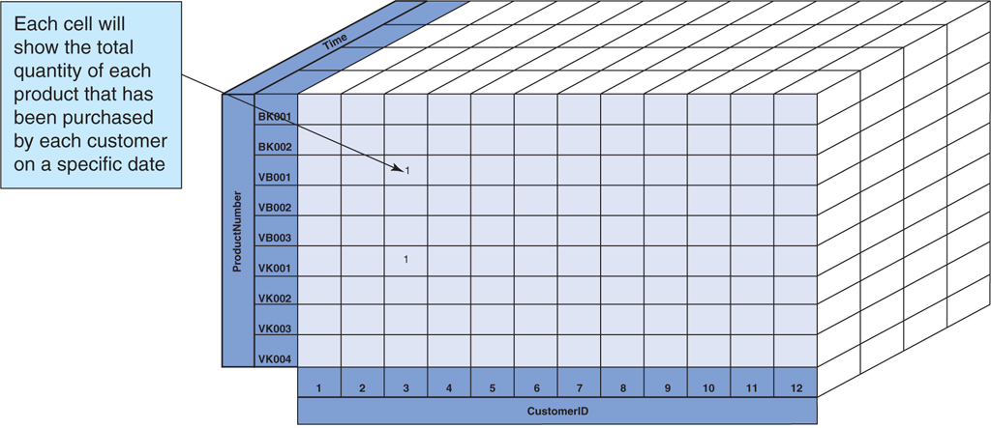
Three-Dimensional Matrix
Figure 8-14: The Three-Dimensional Time–ProductNumber–CustomerID Cube

Slide 21
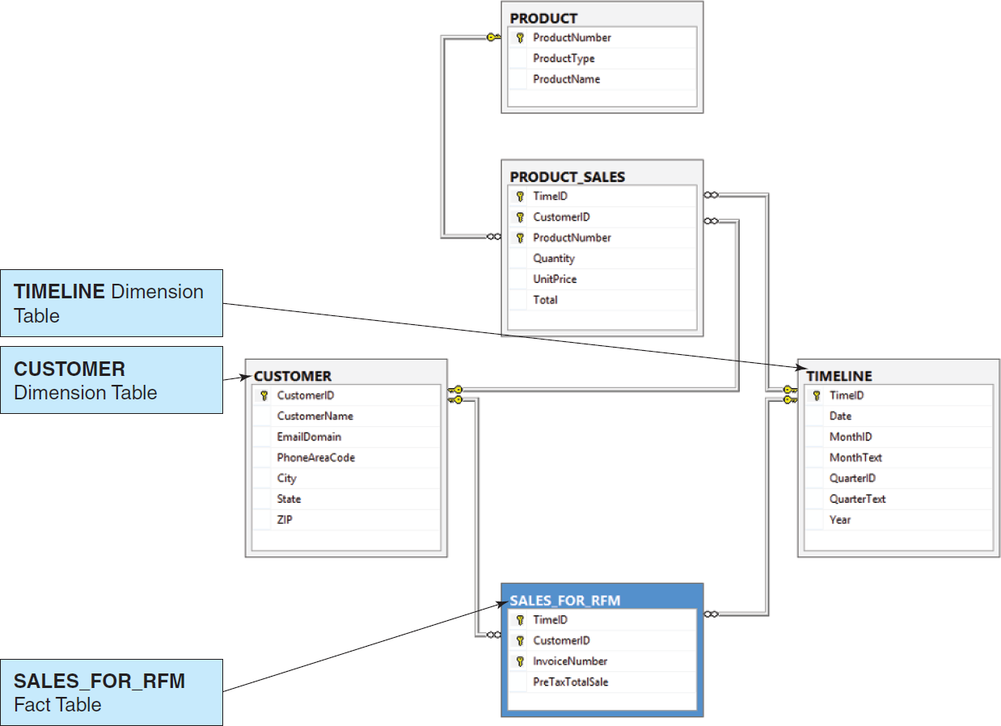
Conformed Dimensions and the Extended HSD-DW Schema
Figure 8-15: The Extended HSD-DW Star Schema

Slide 22
OnLine Analytical Processing (OLAP)
OnLine Analytical Processing (OLAP) is a technique for dynamically examining database data.
OLAP uses arithmetic functions such as Sum and Average.

Slide 23
OLAP Reports
OLAP systems produce an OLAP report, also know as an OLAP cube.
The OLAP report uses inputs called dimensions.
The OLAP report calculates outputs called measures.
Excel PivotTables can be used to create OLAP reports.

Slide 24
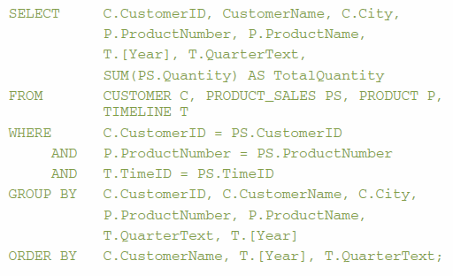
SQL Query for OLAP Data

Slide 25
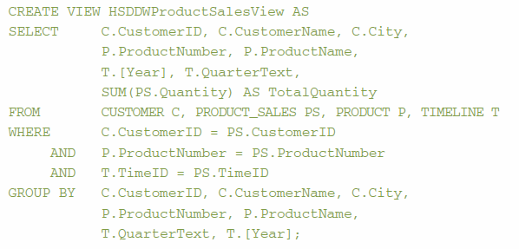
SQL View for OLAP Data

Slide 26
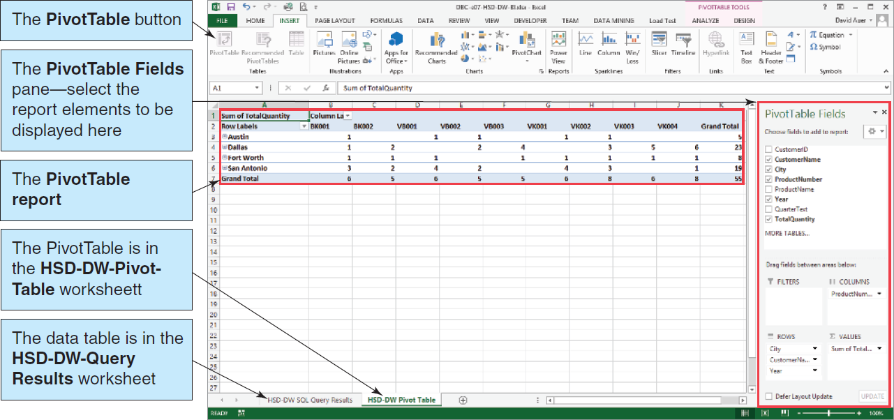
Excel PivotTable OLAP Report I
Figure 8-17: OLAP ProductNumber by City Report

Slide 27
Excel PivotTable OLAP Report II
Figure 8-18: OLAP ProductNumber by City, Customer, and Year Report

Slide 28
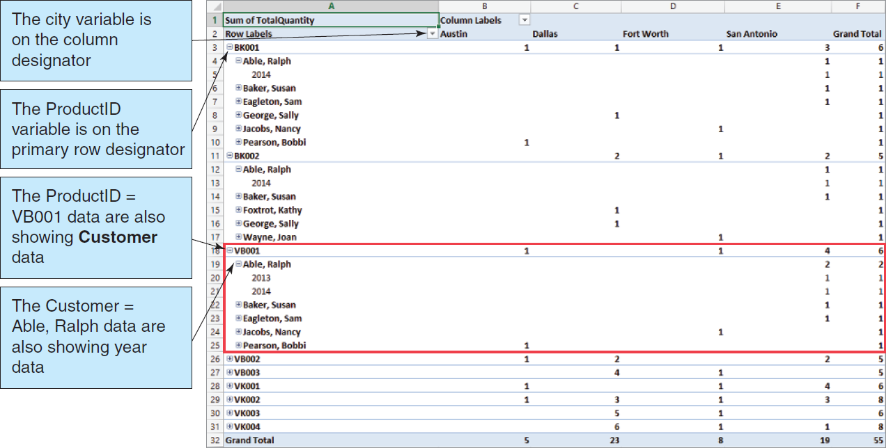
Excel PivotTable OLAP Report III
Figure 8-19: OLAP City by ProductNumber, Customer, and Year Report

Slide 29
Distributed Database Processing
A database is distributed when it is:
Partitioned
Replicated
Both partitioned and replicated
This is fairly straightforward for read-only replicas, but it can be very difficult for other installations.

Slide 30
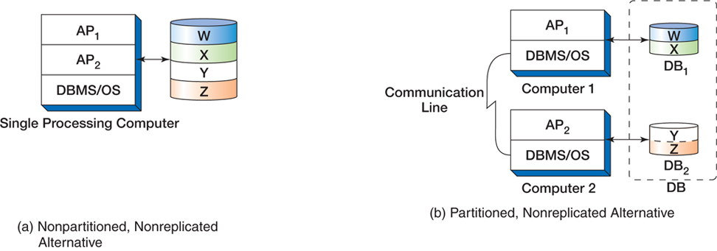
Type of Distributed Databases
Figure 8-20: Types of Distributed Databases

Slide 31
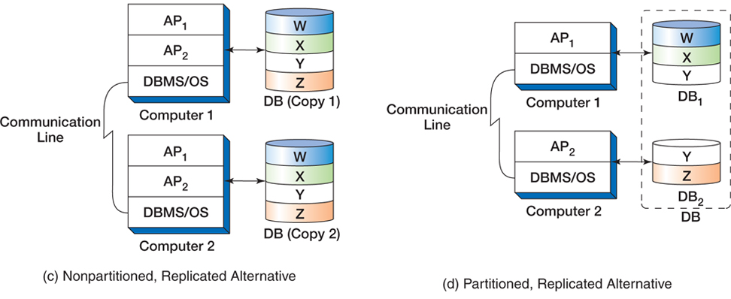
Type of Distributed Databases (Cont’d)
Figure 8-20 Types of Distributed Databases (Cont’d)

Slide 32
Object-Relational Database Management
Object-oriented programming (OOP) is based on objects, and OOP is now used as the basis of many computer programming languages:
Java
VisualBasic.Net
C++
C#

Slide 33
Objects
Object classes have
Identifiers
Properties
These are data items associated with the object.
Methods
These are programs that allow the object to perform tasks.
The only difference between entity classes and object classes are the methods.

Slide 34
Object Persistence
Object persistence means that values of the object properties are storable and retrievable.
Object persistence can be achieved by various techniques.
A main technique is database technology.
Relational databases can be used, but require substantial programming.

Slide 35
OODBMS
Object-Oriented DBMSs (OODBMSs) have been developed.
Never achieved commercial success
It would be too expensive to transfer existing data from relational and other legacy databases.
The OODBMSs were, therefore, not cost justifiable.

Slide 36
Object-Relational DBMSs
Some relational DBMS vendors have added object-oriented features to their products.
Example: Oracle
These products are known as object-relational DBMSs and support object-relational databases.

Slide 37
The NoSQL Movement I
The NoSQL movement is a movement to use non-relational databases.
These databases are often classified into four categories:
Key-Value—Dynamo and MemcacheDB
Document—Couchbase and MongoDB
Column Family—Apache Cassandra and HBase
Graph—Neo4J and AllegroGraph

Slide 38
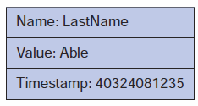
Column Family Databases: A Column
(a) A Column
Figure 8-21: A Generalized Column Family Database Storage System

Slide 39
Column Family Databases: A Super Column
(b) A Super Column
Figure 8-21: A Generalized Column Family Database Storage System (Cont’d)

Slide 40
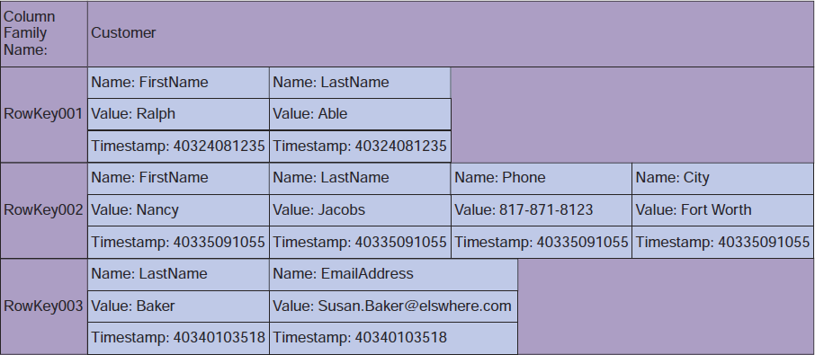
Column Family Databases: A Column Family
(c) A Column Family
Figure 8-21: A Generalized Column Family Database Storage System (Cont’d)

Slide 41
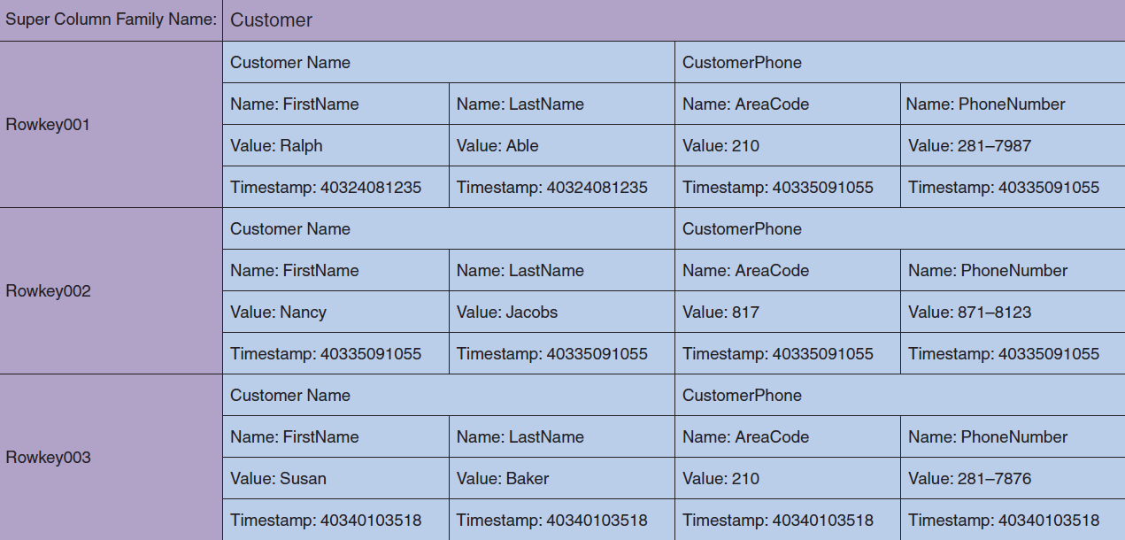
Column Family Databases: A Super Column Family
(d) A Super Column Family
Figure 8-21: A Generalized Column Family Database Storage System (Cont’d)

Slide 42
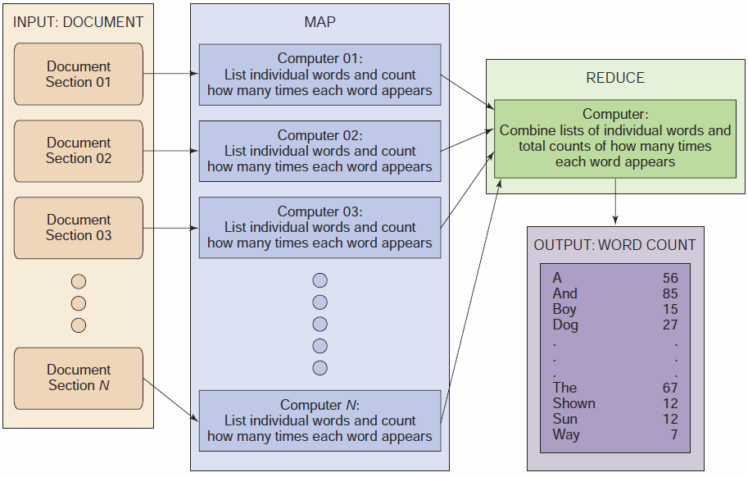
The MapReduce Process
Figure 8-22: MapReduce

Slide 43
DAVID M. KROENKE and DAVID J. AUER
DATABASE CONCEPTS, 7th Edition
All rights reserved. No part of this publication may be reproduced, stored in a retrieval system, or transmitted, in any form or by any means, electronic, mechanical, photocopying, recording, or otherwise, without the prior written permission of the publisher. Printed in the United States of America.
Copyright © 2015 Pearson Education, Inc.
Publishing as Prentice Hall

Slide 44
Big Data, Data Warehouses, and Business Intelligence Systems
DAVID M. KROENKE and DAVID J. AUER
DATABASE CONCEPTS, 7th Edition
End of Presentation on Chapter Eight

